Slide 1
자료구조 및 알고리즘 - Priority Queues (Heap)
Taehyoun Kim
Dept. of Mechanical & Information Engineering,
University of Seoul

Slide 2
Background
Many applications require that we process records with keys in order, but not necessarily in full sorted order and not necessarily all at once.
A priority queue is a data structure of items with keys that supports two basic operations:
Insert a new item
Remove the item with the smallest (largest) key (priority)
Comparison with Stack and Queue
Application of priority queues
Event simulation systems
Process scheduling in OS

Slide 3
Priority Queue ADT
Priority queue Q supports the following basic operations
Insert(x, Q)
y = DeleteMin(Q)
Other operations may be supported for priority queues
Construct (Build) a priority queue from N given items
Change the priority of an arbitrary specified item
Join two priority queues into one large one

Slide 4
Elementary Implementations
 | Insert | Remove minimum | Find minimum | Change priority
Ordered Array | N | 1 | 1 | N
Ordered List | N | 1 | 1 | N
Unordered Array | 1 | N | N | 1
Unordered List | 1 | N | N | 1
Heap | lg N | lg N | 1 | lg N
Note that the simple implementations can often outperform more complicated methods in many practical situations.
Only a few “remove the minimum” operations (many insertions)
Many “find the minimum” compared with insertions

Slide 5
Heap Data Structure
A heap is a set of nodes with keys arranged in a complete heap-ordered binary tree, represented as an array.
Structure Property
Complete Binary Tree, with the possible exception of the leaves, which is filled from left to right.
Heap Order Property
The smallest element should be at the root.
The key of any node should be smaller than or equal to all of its descendants.

Slide 6
Binary Heaps
Binary Heap : A Complete, Partially Ordered Binary Tree
Complete Tree: with height h, there are between 2^{h} and (2^{h+1} – 1) nodes.
Partially Ordered Tree: the key of each internal node is less than or equal to the keys of its children
Binary Heap can be stored in Arrays since it is complete!
13
13
21
14
21
14
24
31
19
68
6
31
19
68
65
26
32
65
26
32

Slide 7
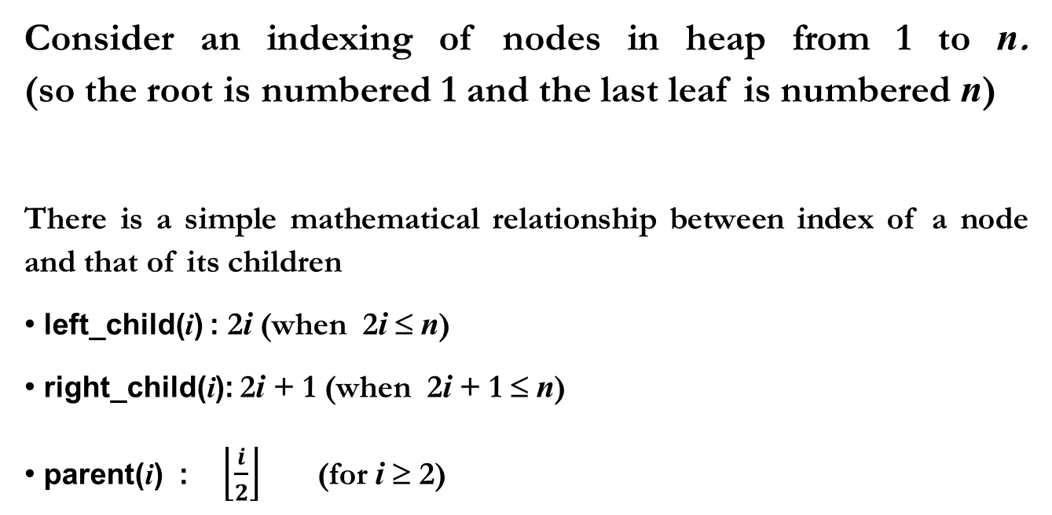
Array Implementation of a Heap
Consider an indexing of nodes in heap from 1 to n. (so the root is numbered 1 and the last leaf is numbered n)
There is a simple mathematical relationship between index of a node and that of its children
left_child(i) : 2i (when 2i ≤ n)
right_child(i): 2i + 1 (when 2i + 1 ≤ n)
parent(i) : $\left\lfloor \frac{i}{2}\right\rfloor$ (for i ≥ 2)

Slide 8
Array Implementation of a Heap
Min Heap example
13
21
14
24
31
19
68
65
26
32
 | 13 | 21 | 14 | 24 | 31 | 19 | 68 | 65 | 26 | 32
array
index
0 1 2 3 4 5 6 7 8 9 10 11

Slide 9
Insertion into a Heap
Put into the next available leaf node (this is simple since it is an array)
Look at the parent of this element and swap if the parent is larger
(note that the partial ordering is preserved)
Repeat with the parent (sifting/percolating up)

Slide 10
Insertion into a Heap
struct HeapStruct
{
int Capacity; // max heap capacity
int Size; // current heap size
ElementType *Elements; // Array
};
void
Insert( ElementType X, PriorityQueue H )
{
int i;
if (IsFull( H ) )
{
Error( “Priority queue is full” );
return;
}
// percolate up until the heap-order property is met
i = ++H->size;
for( ; i > 1 && H->Elements[ i/2 ] > X ; i /= 2 )
H->Elements[ i ] = H->Elements[ i/2 ];
H->Elements[ i ] = X;
}
13
21
16
24
31
19
68
65
26
32
14
⇒
13
14
16
24
21
19
68
65
26
32
31
Notes:
for loop 의 시행 횟수 log N

Slide 11
DeleteMin
Remove the root from the tree and return its value.
Remove the rightmost leaf and place it at the root.
Perform sifting/percolating down operations (if the key is larger than the smaller of its two children, then swap these two. Repeat this.)
13
31
15
14
15
14
⇒
24
21
19
68
24
21
19
68
31
65
26
32
65
26
32
⇓
14
14
31
15
19
15
⇐
24
21
31
68
24
21
19
68
65
26
32
65
26
32

Slide 12
DeleteMin
void PercolateDown(int i, PriorityQueue H)
{
int Child, tmp = H->Elements[i];
// percolate down
for( ; i*2 <= H->Size ; i = Child )
{
Child = i * 2;
// Check for single child case (# of nodes are an even number)
if( Child != H->Size && (H->Elements[ Child + 1 ] < H->Elements[ Child ] ))
Child++;
if( tmp > H->Elements[ Child ] )
H->Elements[ i ] = H->Elements[ Child ];
else // The heap-order property is met. Then exit.
break;
}
H->Elements[ i ] = tmp;
}
ElementType DeleteMin( PriorityQueue H )
{
ElementType MinElement,;
MinElement = H->Elements[ 1 ];
H->Elements[ 1 ] = H->Elements[ H->Size-- ];
PercolateDown (1, H);
return MinElement;
}

Slide 13
Other Heap Operations
Change Priority (Key value) at the position P by the amount delta
DecreaseKey (P, delta, H)
IncreaseKey (P, delta, H)
Remove the node at the position P
Delete (P, H) ← DecreaseKey (P, infinity, H) and DeleteMin
Construct a Heap
BuildHeap(H)

Slide 14
Building a Heap
Build a Heap containing n keys.
takes O(n lg n) with consecutive insertions
But it can take O(n) if they are already in array.
Starting with the lowest non-leaf node, working back towards root, perform sift-down on each node of the tree
21
21
65
68
65
68
⇒
31
13
24
19
14
13
24
19
14
32
26
31
32
26
⇓
13
21
14
19
13
19
⇐
14
26
24
68
21
26
24
68
31
32
65
31
32
65
Notes:
root에서 시작해서 percolate-up 할 수도 있기는 하지만, 그럴 경우 leaf 까지 테스트하게 되어서 더 많은 노드를 봐야 함.

Slide 15
Building a Heap
void BuildHeap(PriorityQueue H)
{
int i;
for (i = H->Size/2 ; i > 0 ; i--)
PercolateDown (i, H);
}
21
21
65
68
65
68
⇒
31
13
24
19
14
13
24
19
14
32
26
31
32
26
⇓
13
21
14
19
13
19
⇐
14
26
24
68
21
26
24
68
31
32
65
31
32
65
Notes:
root에서 시작해서 percolate-up 할 수도 있기는 하지만, 그럴 경우 leaf 까지 테스트하게 되어서 더 많은 노드를 봐야 함.

Slide 16
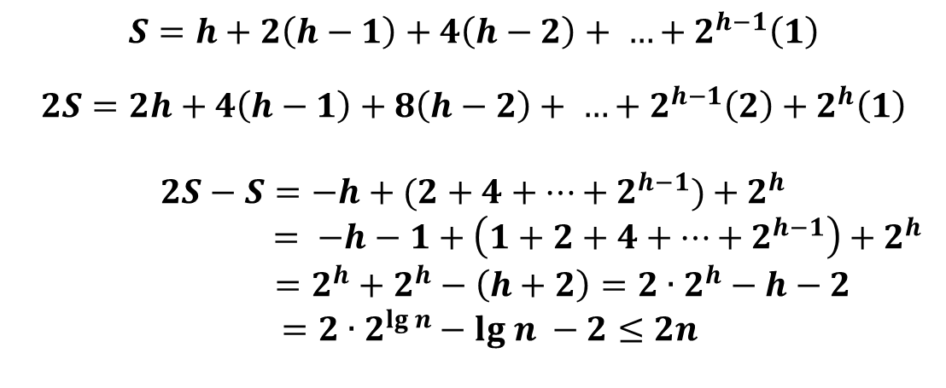
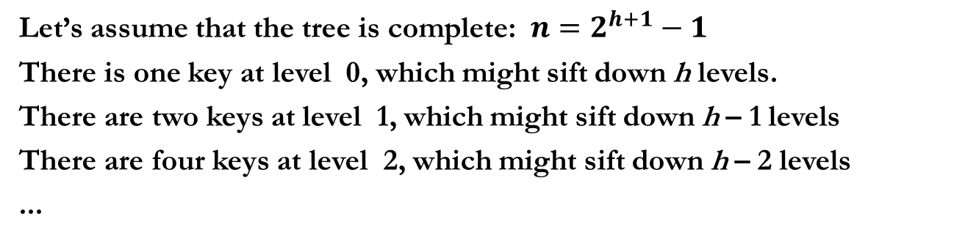
Analysis of Building a Heap
Let’s assume that the tree is complete: $n=2^{h+1}−1$
There is one key at level 0, which might sift down h levels.
There are two keys at level 1, which might sift down h – 1 levels
There are four keys at level 2, which might sift down h – 2 levels
...
$$S=h+2\left(h−1\right)+4\left(h−2\right)+ …+2^{h−1}\left(1\right)$$
$$2S=2h+4\left(h−1\right)+8\left(h−2\right)+ …+2^{h−1}\left(2\right)+2^{h}\left(1\right)$$
$$2S−S=−h+(2+4+…+2^{h−1})+2^{h}$$
$$= −h−1+\left(1+2+4+…+2^{h−1}\right)+2^{h}$$
$$=2^{h}+2^{h}−\left(h+2\right)=2∙2^{h}−h−2$$
$=2∙2^{lg n}−lg n −2≤2n$

Slide 17
Application of Heaps
Heap sorting
Inserting keys in a Heap (O(n)), then repetitively applying DeleteMin (O(n log n)): Most Basic Sorting Algorithm
Process (Job) Scheduling in Operating Systems
Typically modern OSes tend to schedule multiple processes according to their priorities
Event Simulation
Statistical analysis for how long on average a customer has to wait in a bank with k tellers.

